Slide 1
Time Value of Money
APSC 221 – Week 1
Summer 2024

Slide 2
Would you take a dollar from me today, or at the end of the term?

Slide 3

Introduction
Engineering decisions nearly universally require making decisions on tradeoffs that occur at different times
ie. Investing now to get a benefit in the future.
How do we make those comparisons in a fair manner?

Slide 4

Interest & Interest Rates
Given the choice of money today or tomorrow, most would prefer money today to put to a productive use.
What is Interest?
Compensation for giving up money today (recall definition of opportunity cost)
Also to pay for administrative costs and risk profile

Slide 5
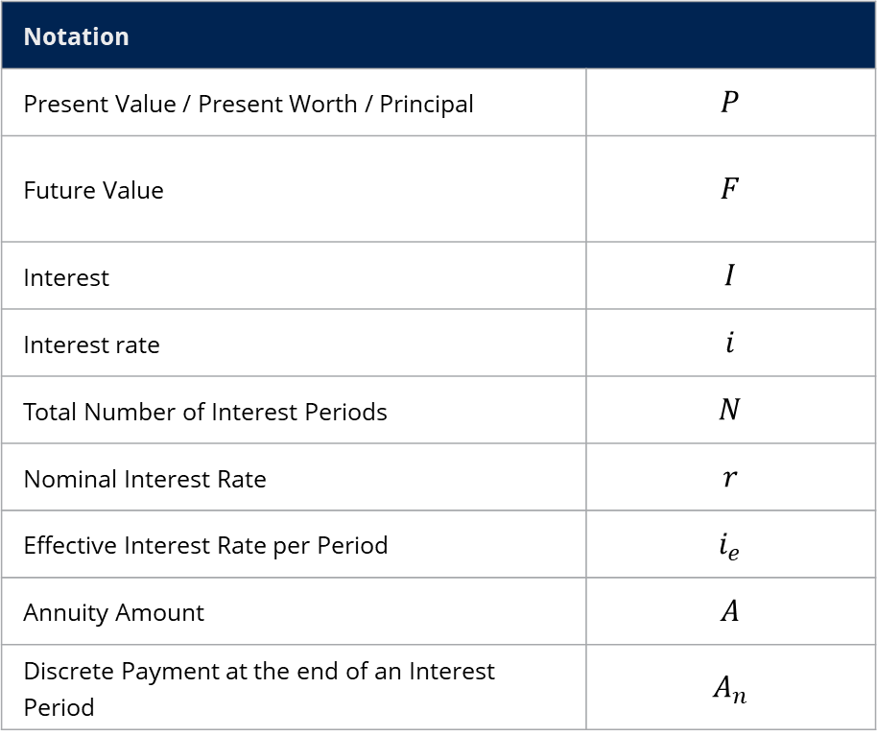
Key Notation
Notation
Present Value / Present Worth / Principal | $$P$$
Future Value | $$F$$
Interest | $$I$$
Interest rate | $$i$$
Total Number of Interest Periods | $$N$$
Nominal Interest Rate | $$r$$
Effective Interest Rate per Period | $$i_{e}$$
Annuity Amount | $$A$$
Discrete Payment at the end of an Interest Period | $$A_{n}$$

Slide 6
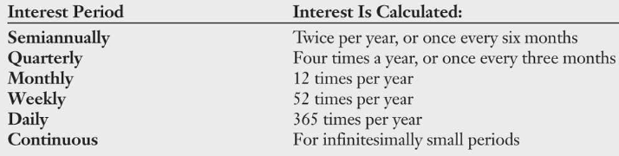
Interest Rates and Periods
Interest is expressed as a percentage rate for a given period of time.
ie. 9% interest means $0.09 owed per dollar lent over a given period of time
The base unit of time for interest calculation is known as the interest period.
Sidenote: “Usury Rate”
- Criminal Code of Canada definition for a criminal rate of effective annual interest exceeding 60%.

Slide 7
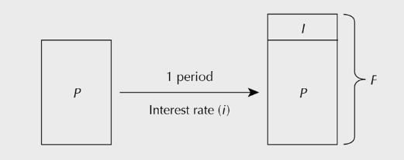


Present and Future Worth
Simply put, the future amount, $F$, is the amount of money today, $P$, plus the interest.
$$F=P+I$$
$$=P+Pi$$
$$=P(1+i)$$

Slide 8
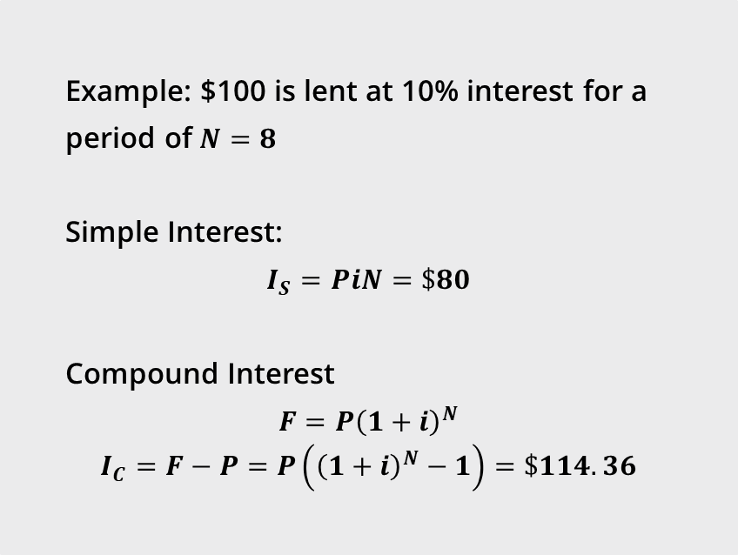
Simple vs Compound Interest
Simple interest is simply paying interest on the principal.
Compound interest is paying interest on the principal and accrued interest value. In effect, the interest calculation can be done over multiple periods.
The interest period can also be known as the compounding period.
Example: $100 is lent at 10% interest for a period of $N=8$
Simple Interest:
$$I_{S}=PiN=\$80$$
Compound Interest
$$F=P{\left(1+i\right)}^{N}$$
$$I_{C}=F−P=P\left({\left(1+i\right)}^{N}−1\right)=\$114.36$$

Slide 9
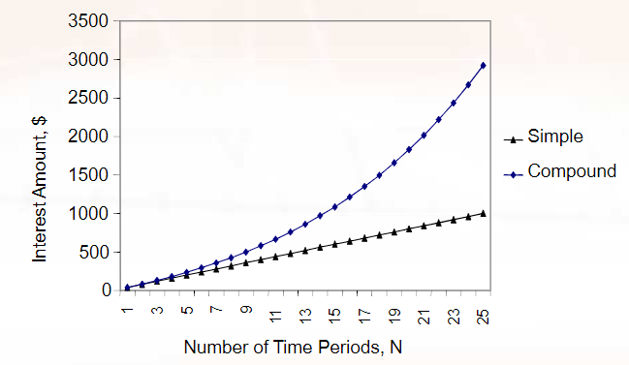
Simple vs Compound Interest

Slide 10
Nominal and Effective Interest Rates
Interest rates are stated for a given period of time (usually per year), but computation may be needed on shorter, compounding periods
The “stated rate” is the nominal interest rate.
ie, daily savings account with a rate of 3% interest, or mortgages with a rate of 6%.
Unless specified, nominal interest rates are assumed to be annual.
So, how do we get an interest rate that we can use in our calculations when the compounding period is not the same as the nominal period?
We need to convert to an effective interest rate.

Slide 11

Converting Nominal and Effective Rates
Suppose that:
$r$ is the nominal stated rate for the period
with the period consisting of:
$m$ equal compounding sub-periods
Then:
the compound interest rate per sub period is $i_{s}=r/m$
and after $m$ sub-periods:
$$F=P{\left(1+i_{s}\right)}^{m}$$

Slide 12

Converting Nominal and Effective Rates, cont’d
As the goal of interest rate conversions is to ensure there is no arbitrage,
we need an effective annual interest rate, $i_{e}$:
$$F=P{\left(1+i_{s}\right)}^{m}=P\left(1+i_{e}\right)$$
We get:
$$i_{e}={\left(1+i_{s}\right)}^{m}−1$$
or
$$i_{e}={\left(1+\frac{r}{m}\right)}^{m}−1$$

Slide 13
Cash is KING

Slide 14
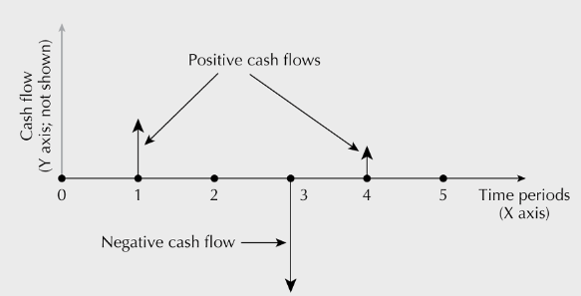
Cash Flow Diagrams
Graphical representation to summarize the timing and magnitude of cash flows
KEY RULES:
Cash flows occur at the end of a period.
End of Period 1 is the start of Period 2.
“Now” is Time Zero (“0”)

Slide 15
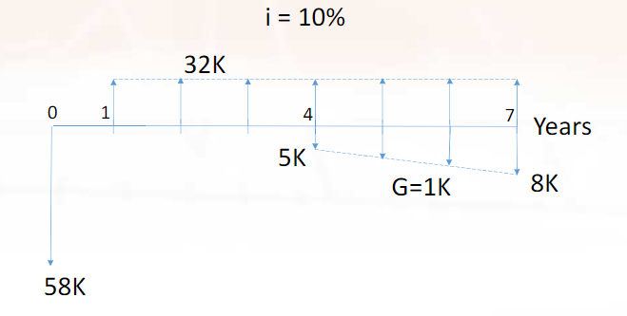
Cash Flow Diagram Example

Slide 16
Equivalence
As we make decisions on cost/benefits occurring at different times, we need to be able to assume that values are equivalent.
We distinguish 3 kinds of equivalency:
Mathematical
Decisional
Market
Mathematical Equivalency
The calculations we are conducting in this course to equate present and future values.
Decisional Equivalency
- A decision maker is indifferent between money now or in the future.
Market Equivalency
A decision maker can exchange cash flows at zero cost (ie, ignore administrative costs)
We will assume in this course that market equivalence is true, and that decisional equivalency is monetarily quantifiable.

